Slide 1

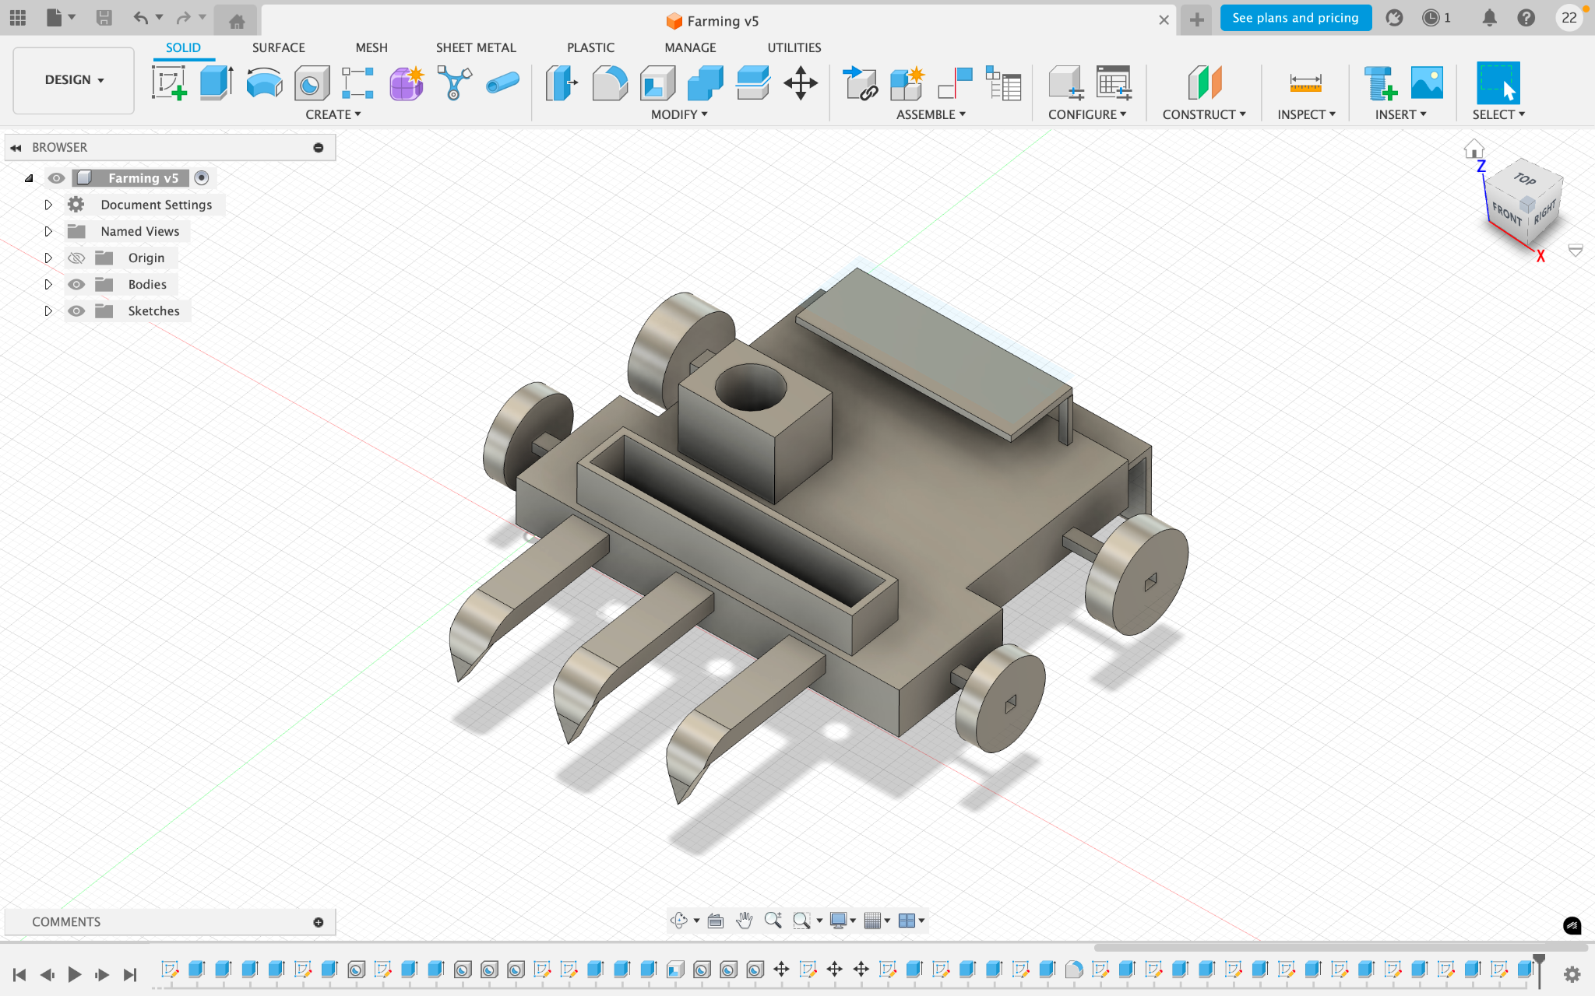
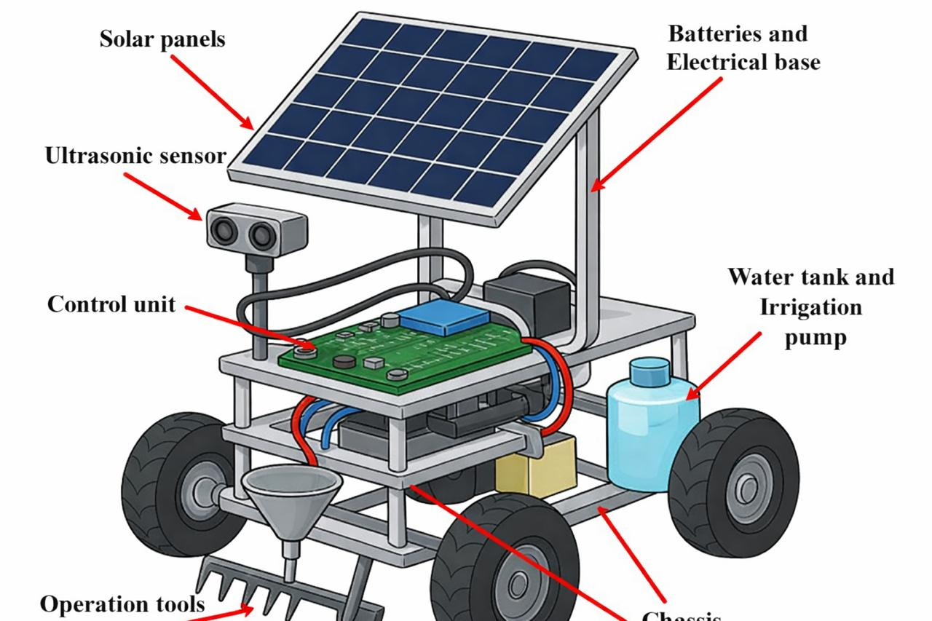
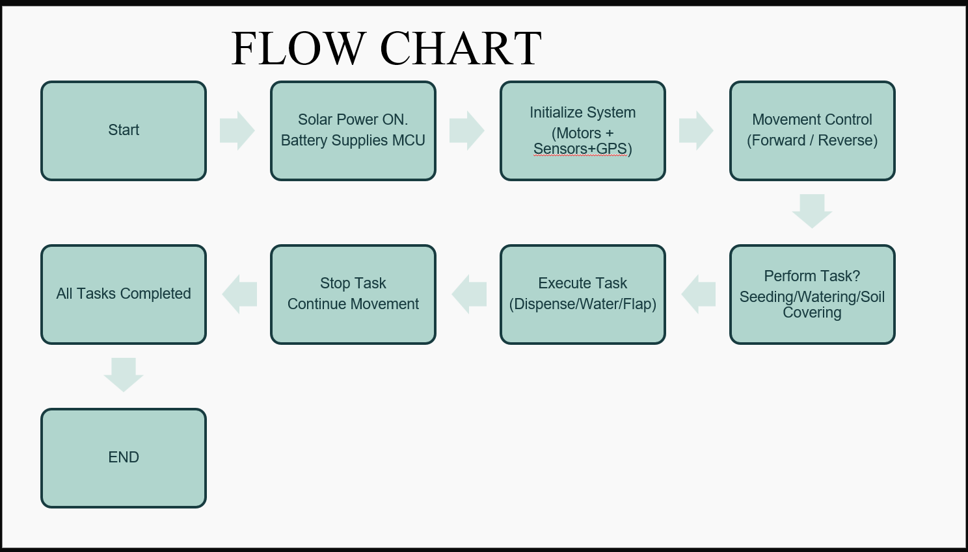
AgroTrack Bot: Solar-Powered Farming Robot with GPS Tracking 2310040006 (Kaavya),2310040003(Prashanthi),2310040009(Abinanya),2310040011(Akshaya) Courses: Embedded and Real-time Systems & Embedded Prototype
Electronics and Communication Engineering Department, Aziz Nagar, Hyderabad, Telangana, India
Supervised by
Dr. Abhishek Kumar , Mrs Madhavi , Dr.A.Prasanna Lakshmi , Dr.C.Joshitha and Dr Amit Srivastava
Abstract
Performance Comparison and Discussions
AgroTrack Bot is a solar-powered, GPS-enabled agricultural robot designed to automate major farming activities.
The robot performs multiple tasks such as seed sowing, ploughing, watering, seed covering, and obstacle detection with improved accuracy and efficiency.
It operates entirely on renewable solar energy, making the system eco-friendly and cost-effective for farmers.
An ESP32 microcontroller is used as the main control unit to manage movement, task execution, and sensor operations.
Ultrasonic sensors are integrated for real-time obstacle detection, ensuring safe and autonomous field navigation.
GPS tracking enables location monitoring and precision-based farming operations.
The system is especially suitable for rural and off-grid areas where conventional power sources may not be available.
The proposed model reduces labor dependency, increases productivity, and promotes smart and sustainable agriculture practices.
Parameter | Existing Models | Proposed AgroTrack Bot
POWER SOURCE | FUEL / BATTERY | SOLAR + BATTERY
SENSORS USED | IR / CAMERA | ULTRASONIC + GPS(NEO-6M)
ENERGY USE | MODERATE TO HIGH | 45-50% Reduced
OPERATIONAL COST | HIGH | ~60% LOWER
TASKS | MOSTLY SINGLE-TASK | PLOUGHING,SOWING,IRRIGATION (MULTI-TASK)
OBSTACLE DETECTION | 70-85% ACCURACY | ~95% ACCURACY
LIMITATION | HIGH COST,LIMITED BATTERY,FUEL DEPENDENCY | ECO-FRIENDLY,COST-EFFECTIVE, SUITABLE FOR AGRICULTURE USE
Introduction
Agriculture is vital for national development but faces labor shortages, high fuel costs, and low efficiency.
Traditional farming methods are time-consuming and economically unstable during peak seasons.
Automation and smart technologies can improve productivity and reduce manual effort.
The proposed system is a solar-powered agricultural robot for ploughing, seed sowing, and irrigation.
It uses an ESP32 microcontroller and an ultrasonic sensor for obstacle detection and efficient operation.
The system promotes sustainable, energy-efficient, and cost-effective farming practices.
Our model helps in reducing fuel dependency, minimizing labor, lowering cost, and enabling smart, sustainable farming.
Proposed Shielded Geometry And Model
Conclusion
The proposed AgroTrack Bot effectively integrates solar energy, automation, and GPS tracking to perform essential agricultural operations.
The robot efficiently carries out ploughing, seed sowing, irrigation, and obstacle detection with minimal human intervention.
Powered completely by solar energy, the system reduces dependency on non-renewable fuels, making it eco-friendly and sustainable.
The ESP32 microcontroller, ultrasonic sensors, and NEO-6M GPS module ensure reliable control, real-time tracking, and accurate field navigation.
Experimental results show improved energy efficiency, operational accuracy, and cost-effectiveness compared to traditional farming methods.
The modular design enables easy integration of additional tools such as pesticide sprayers, fertilizer units, and advanced irrigation systems.
The system supports smart and sustainable agriculture by reducing farmer workload and increasing productivity in small and medium-scale farms.
Future enhancements may include IoT-based remote monitoring, AI-driven path planning, and soil health analysis sensors for advanced precision farming.
The system starts when solar power charges the battery and powers the ESP32 microcontroller.
All components such as motors, ultrasonic sensor, and GPS module are initialized.
The robot begins moving across the field using programmed navigation.
The system checks which task needs to be performed (seeding, watering, or soil covering).
The respective mechanism is activated to execute the task.
After completing the task at that position, the robot continues movement.
The process repeats until all field tasks are completed.
Once all operations are finished, the system stops automatically.
References
P. Singh, A. Sharma, and R. Verma, “Design and Implementation of Solar-Powered Agricultural Robot for Multi-Task Farming,” International Journal of Advanced Research in Electronics and Communication Engineering, vol. 10, no. 5, pp. 245–250, 2023.
A. Kumar and M. Joshi, “Automation in Agriculture Using Renewable Energy and IoT Integration,” IEEE Transactions on Sustainable Energy, vol. 12, no. 3, pp. 480–488, 2022.
S. Patel, K. Reddy, and B. Rao, “Development of Multi-Functional Agricultural Robot Using ESP32 Microcontroller,” Journal of Robotics and Control Systems, vol. 8, no. 2, pp. 76–83, 2024.
N. Gupta and V. Mehta, “Design and Performance Evaluation of a Solar-Powered Field Robot for Precision Agriculture,” International Journal of Mechanical and Production Engineering Research and Development, vol. 11, no. 7, pp. 167–174, 2023.
R. Thomas, J. David, and P. Joseph, “Smart Farming Technologies Using IoT and Renewable Energy Sources,” IEEE Access, vol. 9, pp. 155432–155440, 2021.

